Slide 1

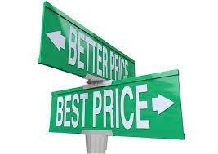
Comparing Across Apps
Understanding Value Seekers
Kelly Peterson
Date: June 12, 2023

Slide 2

Research Objectives
We know that a subset of Cx are value seekers who compare cost across multiple apps before placing an order. This research is targeted to understand:
Where do Cx go on each app to look for deals and discounts when ordering? What pathways do they take to compare across apps?
What cost factors are compared and what weight do they hold (e.g. item price, delivery fees, service fees, recommended tips)?
How do Cx make a final decision? What factors have the greatest weight?

Slide 3

Research Approach
RESEARCH PARTICIPANTS
Survey (n=443 DoorDash users)
Included a mix of classic, occasional and DashPass Cx
Included a mix of Cx who compare every time they order vs. less frequently
Data was weighted to correctly reflect the Classic vs. DashPass DoorDash universe
SURVEY
IN-DEPTH INTERVIEWS
10 min Survey
Cx shared the frequency, priorities, decision making factors and approach when comparing across apps before ordering delivery
10, 25 min 1:1 Interviews
Cx shared their mobile screens to show how they compare across apps. Included Cx that compare DoorDash to UberEats, GrubHub as well as other sources
The research brief can be found here.
Notes:
James to link to failed session

Slide 4
How do Cx compare across apps?

Slide 5
While most Cx state that they compare cost across apps…
64%
59%
62%
of Occasional Cx state that they compare prices across apps
of DashPass Cx state that they compare prices across apps
Of Classic Active Cx state they compare prices across apps
Base: n=443 DoorDash users
Source: Comparing Across Apps

Slide 6

… their definition of comparison is not consistent
What does a comparison mean to Cx?
Most frequent
I have thought about what and where I want to order from before I go to any app to order
I go to place an order but high costs cause me to look at other apps
I open an app with the intention of comparing multiple apps
Least frequent
Base: n=443 DoorDash users
Source: Comparing Across Apps

Slide 7
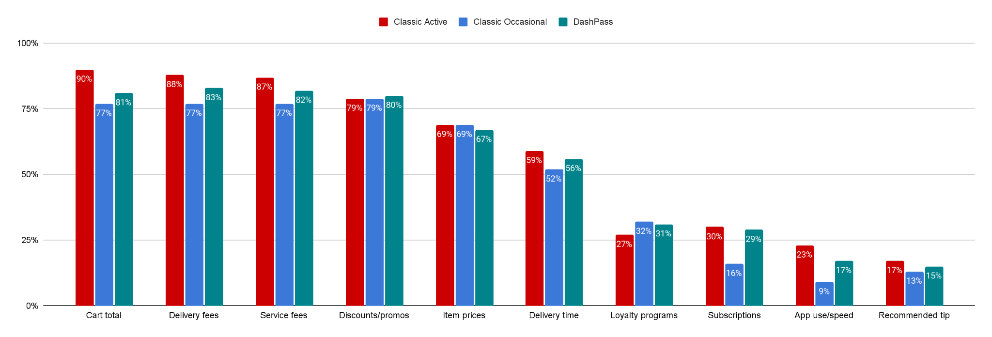

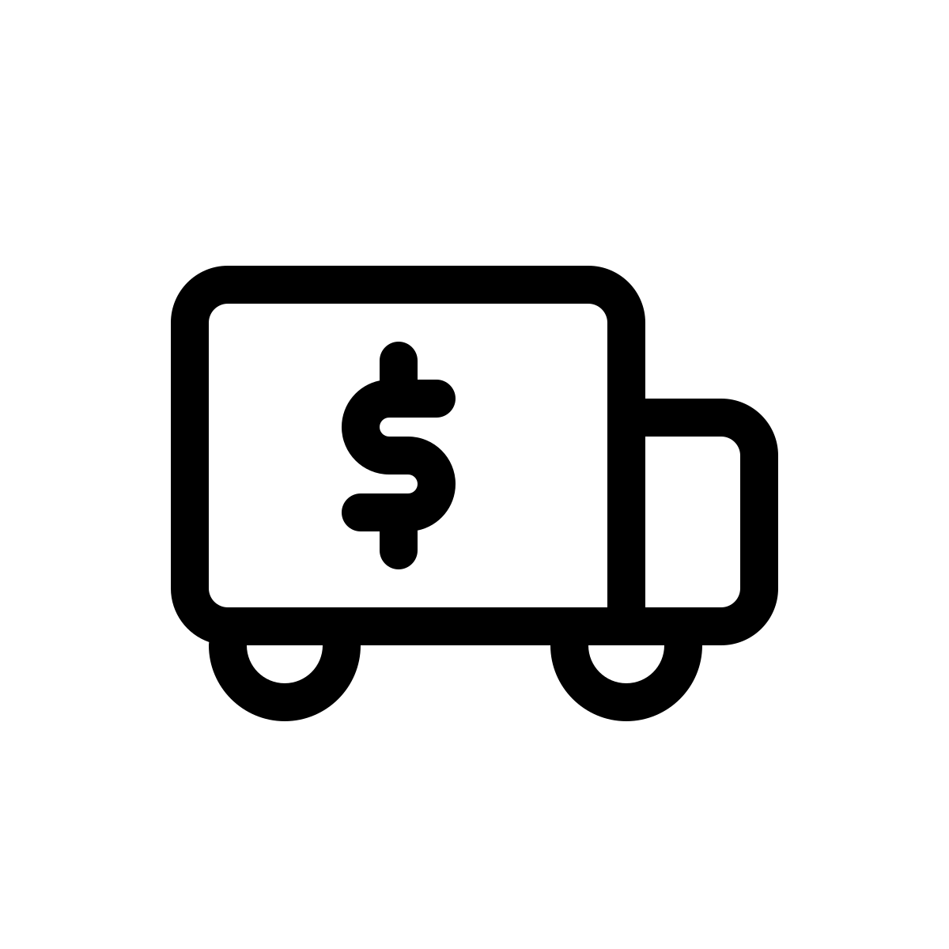



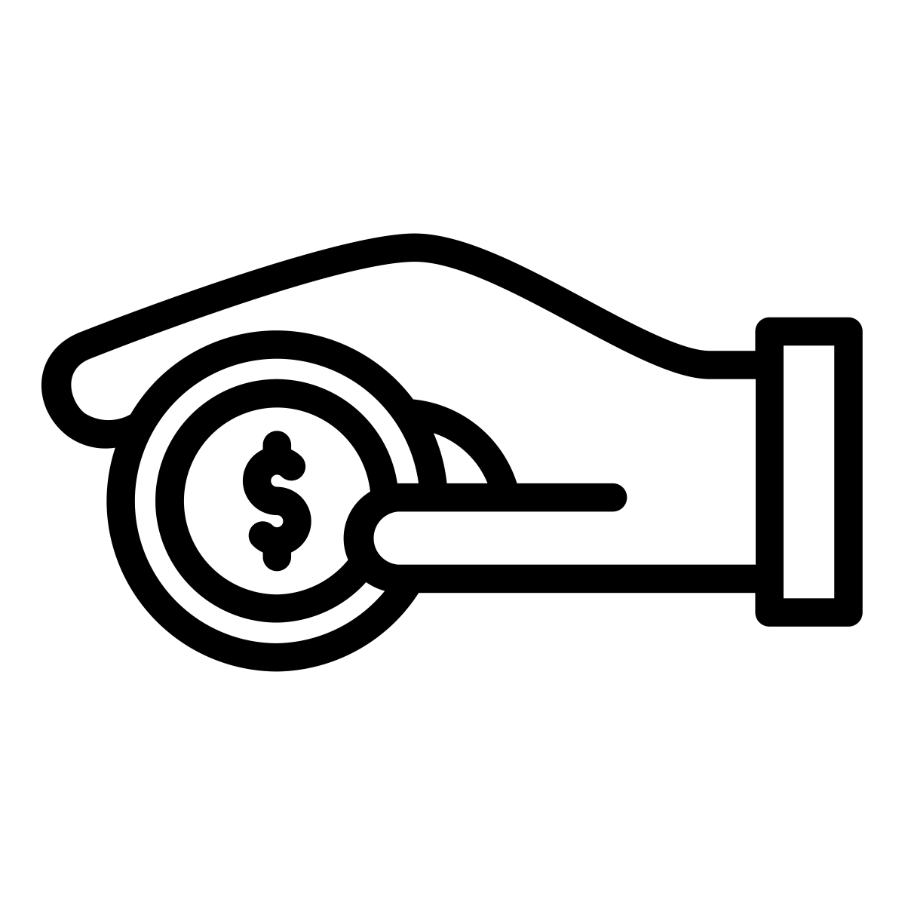




Total cost is the top factor when comparing across apps; quality and loyalty are much less important
Top factors considered when comparing across apps:
Base: n=443 DoorDash users
Source: Comparing Across Apps

Slide 8
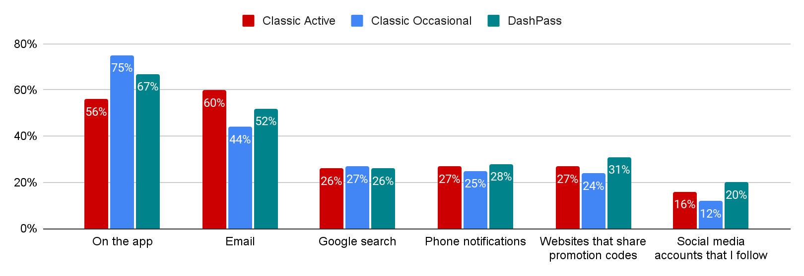
Occasional Cx are more likely to look on apps for deals; in-app savings experience is critical
Top locations where Cx look for savings:
Occasional Cx were less likely to state they notice emails or push notifications from DoorDash, they see them more frequently from UberEats
Occasional Cx mentioned using Twitter, DoorDash Gaming Twitter, and SlickDeals among other websites and social media accounts
Base: n=443 DoorDash users
Source: Comparing Across Apps

Slide 9

In their own words
I check email and apps to see if I have coupons or discounts. Then if not I check to see if different apps have all the items I want (I notice some menus are not the same for different apps but same restaurant). If they do then I use whichever has the better prices.”
Depends on where I am ordering from and if the business is in multiple apps or not. I’ll also compare the pickup vs delivery costs for each app as well if I can pick it up myself.”
Check my preferred app, see what’s available price and discount wise, check a second, and third app to compare prices, fees, etc. Although I typically go with my preferred app since they've treated me well and i have few issues with them.
Honestly, I see who's willing to give me the best price, and if nobody is handing out any promos, I usually go with DoorDash.”
Source: Comparing Across Apps

Slide 10


Start
Have I seen any promos recently
Do I have a specific Rx I want to order from?
No
Yes
Most common comparison journey among value seekers
Is it available across multiple apps?
Yes
No
No
Yes
Order from available app
Search for discounts/promos; are they available on good selection?
Yes
No
Order from app with best discount
Build a cart and order from app with lowest price
Source: Comparing Across Apps

Slide 11


Quality and experience considerations only come into play when prices are similar across apps
Factors for selecting the best discount:
Selection where offer is available
Amount of offer (maximum/free meal)
Ability to stack/apply multiple offers
Minimum requirement for offer
Factors when price is similar
Past experience/quality with app
Menu item availability/ability to customize order
Delivery time
Loyalty programs
Base: n=443 DoorDash users
Source: Comparing Across Apps

Slide 12

Let’s have a Cx walk us through…
Source: Comparing Across Apps

Slide 13


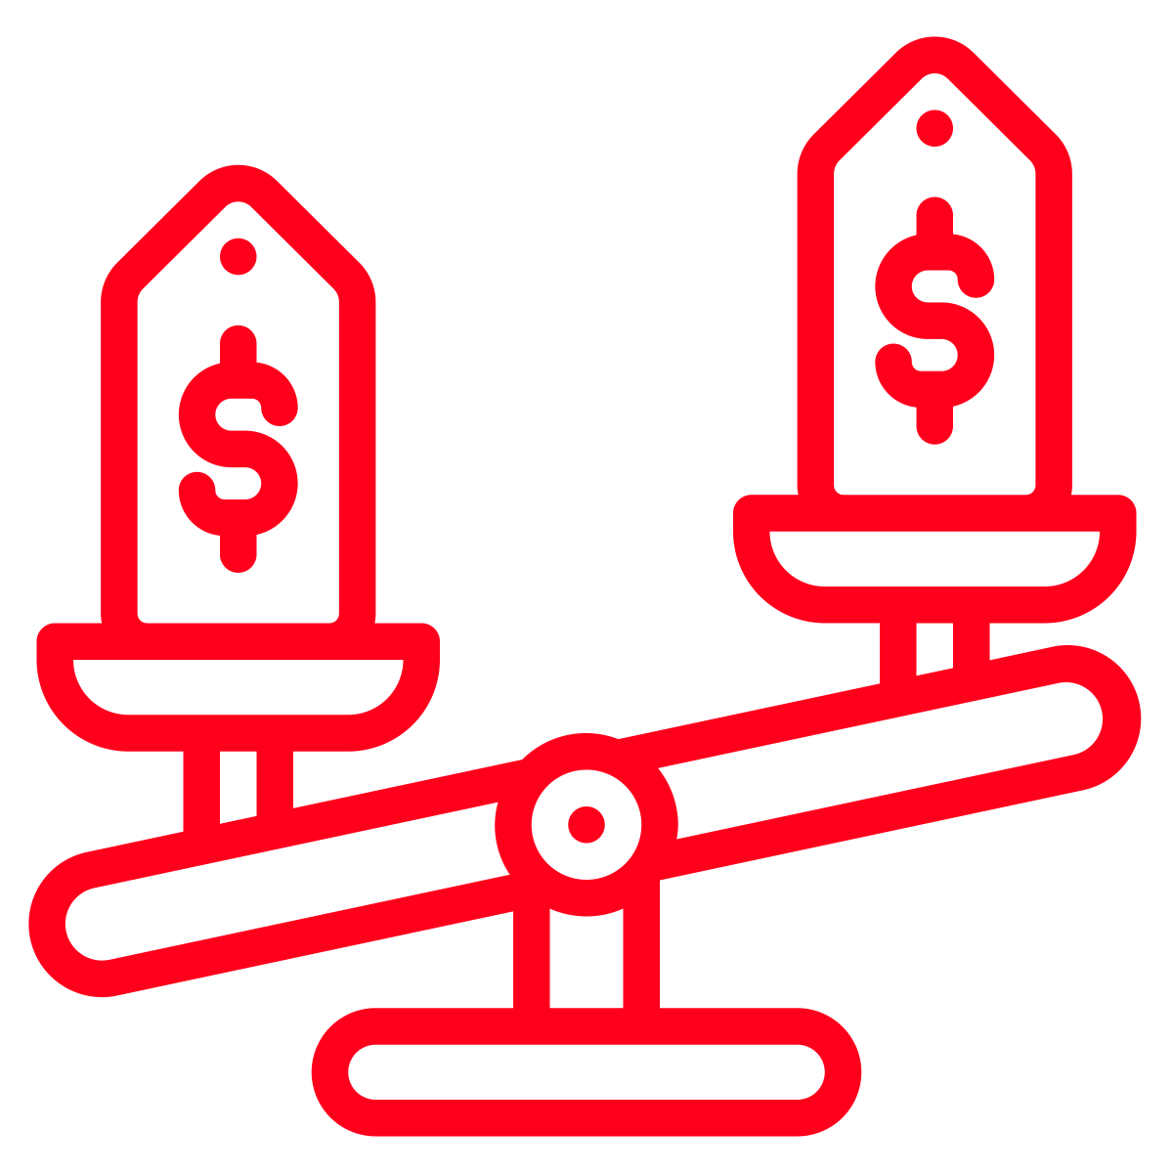

Summary of comparison experience
While Cx are most likely to get information for comparison on app, mental comparisons happen before they even open the app. Mental comparisons consider selection available and promotions received.
When Cx do not have a specific Rx in mind availability of discounts and promotions is often used to help make a decision. Whichever app has the greatest value promotion will win. Value is determined by cost savings and minimum requirements.
When Cx do not have discounts available and a Rx is on multiple apps they will build a cart with the same tip amount to compare prices. Whichever has the lowest cart price wins.
In situations where cart prices are the same or the difference is less than a dollar delivery quality, past experiences and loyalty are considered. For some Cx which app was opened last will be used to place the order.
Source: Comparing Across Apps

Slide 14
What apps most frequently win and why?

Slide 15


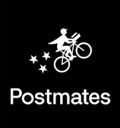

UberEats represents greatest comparison to DoorDash
Apps most frequently compared to DoorDash:
Cx state that they end up ordering from DoorDash most of the time
1.
87%
75%
85%
2.
3.
Classic Active
Classic Occasional
DashPass
4.
Rx-specific apps
Behind DoorDash UberEats is used the second most followed by GrubHub
5.
Base: n=443 DoorDash users
Source: Comparing Across Apps

Slide 16
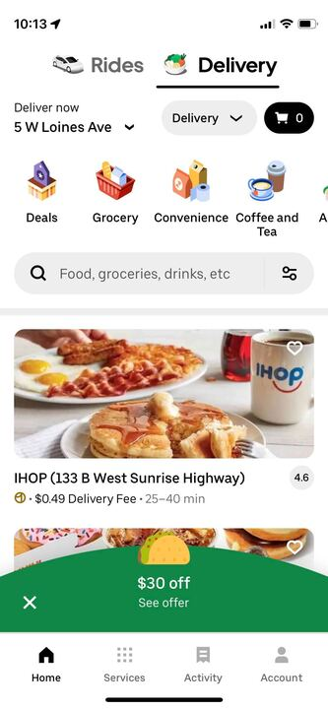
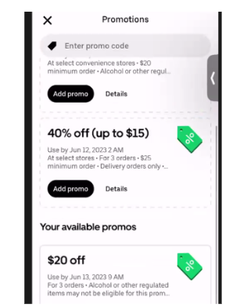
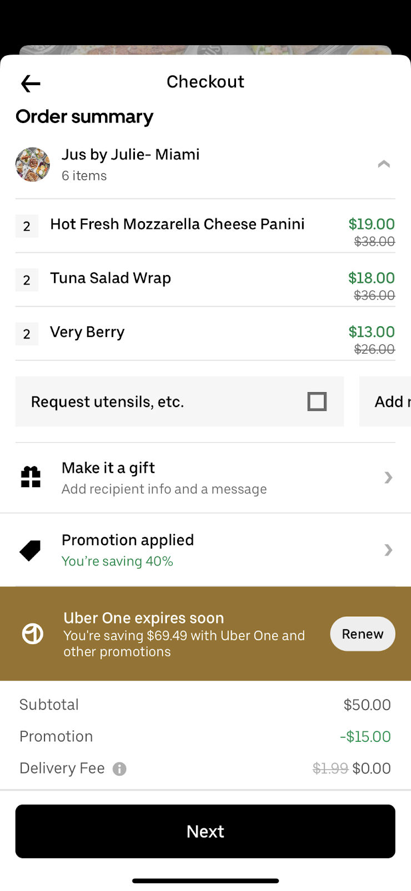
Why do Cx choose UberEats?
UberEats makes it easy to find deals and to see them at checkout. Cx typically turn to UberEats first when they are in a deal-seeking mindset because they are easy to find.
Promotion pop-ups alert Cx to best available savings right away
Cx easily access all promotions from the account page
Savings highlighted & celebrated at checkout
Source: Comparing Across Apps

Slide 17
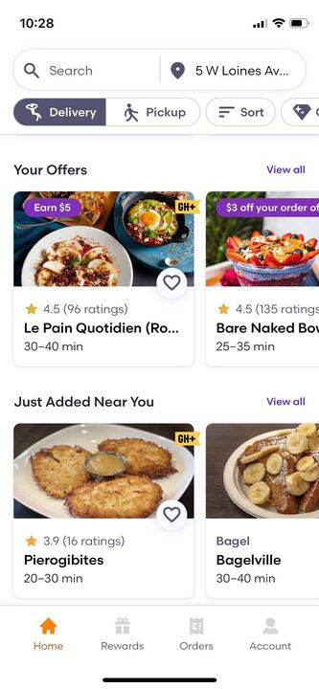
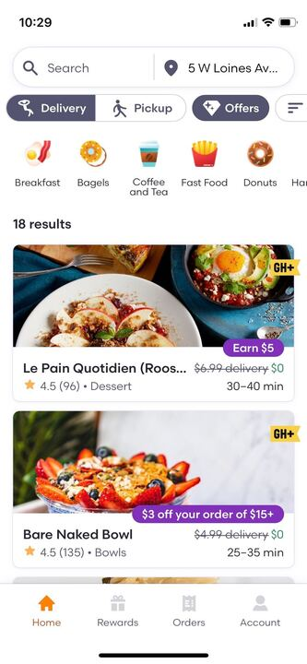
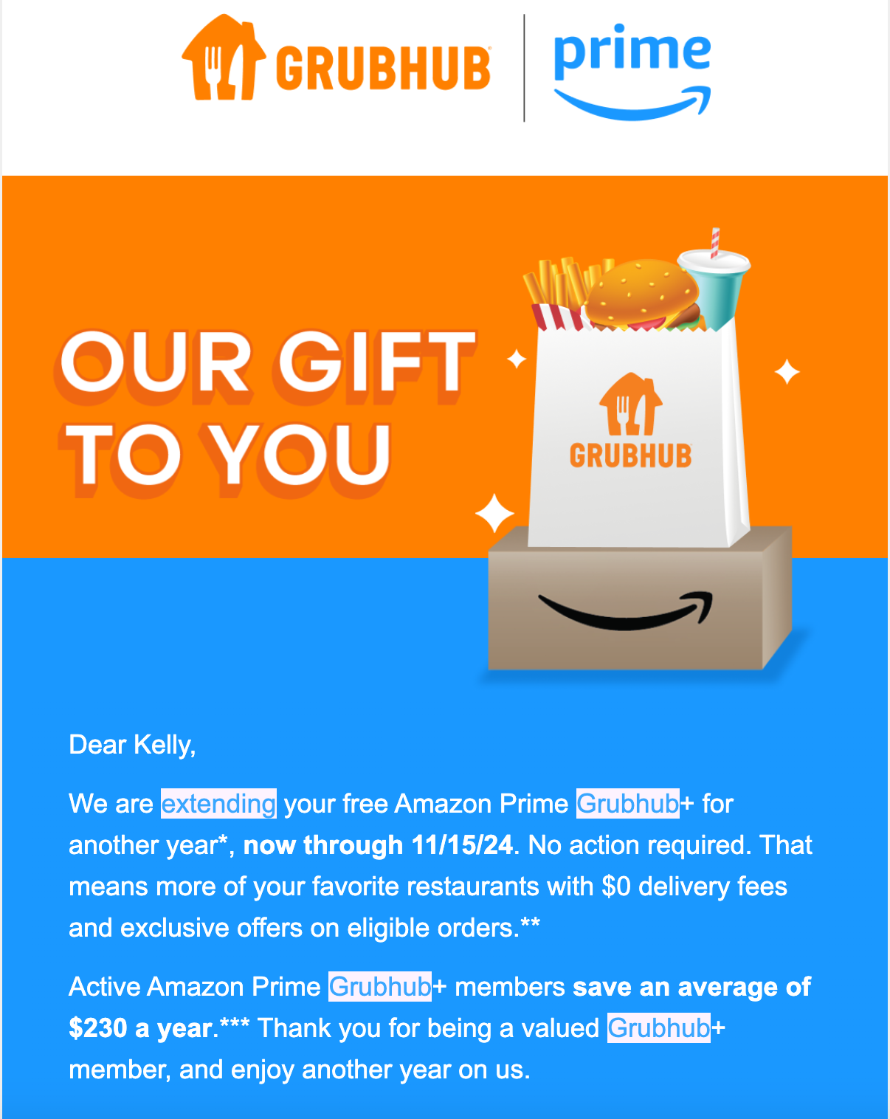
Why do Cx choose GrubHub?
GrubHub is not typically first choice for comparison as it is viewed as very similar in terms of selection, app experience and savings from DoorDash. Most Cx mentioned that they look at GrubHub because they have free access to GrubHub+ from Prime.
Cx need to use an offers filter or scroll on the homepage to access deals
Cx provided with another free year of GrubHub+ via Prime
Source: Comparing Across Apps

Slide 18
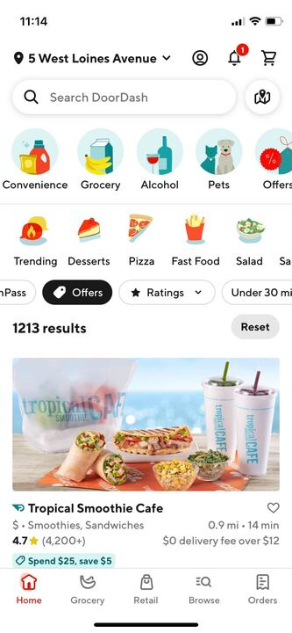
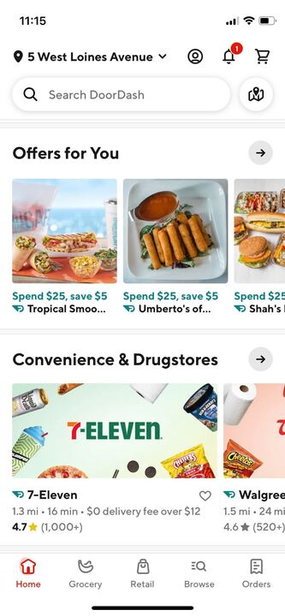
Why do Cx choose DoorDash?
DoorDash is most often selected because of selection, offers and discounts available on delivery fees (through DashPass or other promotions). Some Cx stated that they have a better experience with Dashers than drivers on other apps as well.
Cx need to use an offers filter or scroll on the homepage to access deals and are not always aware of these options. Some Cx have to scroll to their last carousel to see “offers for you”
Source: Comparing Across Apps

Slide 19
What is DoorDash missing?
DoorDash loses most frequently because of the difficult finding, applying and seeing savings.
Source: Comparing Across Apps

Slide 20
What can we do?

Slide 21
Recommended explorations
Create a clear pathway for ways to save
Experiment with different entry points to ensure we have the best approach for occasional Cx
Curate selection of high quality Mx that have stackable offers for early engagement opportunities
Use push notifications to alert Cx to available promos & ToDP beforehand
Explore pop up notifications for ToDP for first few visits to app
Explore higher value savings opportunities with Mx like BOGO
Explore higher minimum/higher savings opportunities for Cx who typically place multiple meal orders
Celebrate and reinforce savings at checkout
Source: Comparing Across Apps

Slide 22
Questions?

